Slide 1
Assessing Knowledge, Attitude and Practices Among Students on E-Learning Platforms
219379C - Pathirana I.A.J

Slide 2
Data Collection
Tool: Google forms
Medium: English
Target population: Undergraduate students in Sri Lanka
Target sample size: 100
The questionnaire was distributed among undergraduate students with the support of friends, and responses were expected from all provinces in Sri Lanka.
Questionnaire was closed after receiving 100 responses

Slide 3
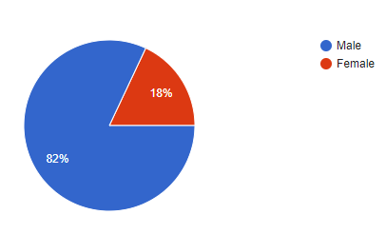
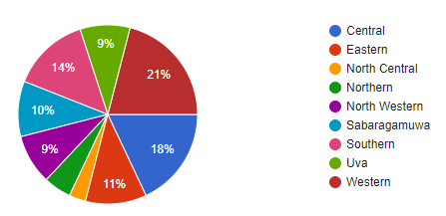
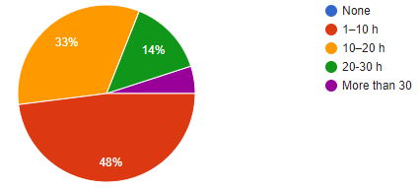
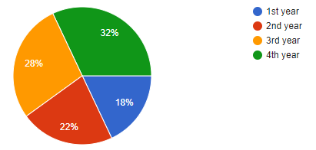
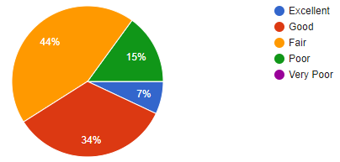
Data
Gender
Province
Time spent on e-learning platforms
Internet connection stability
Academic year

Slide 4
Conclusions
Test 01
Null Hypothesis:
The academic year of the students and the time spent on e-learning platforms are independent.
Alternative Hypothesis:
The academic year of the students and the time spent on e-learning platforms are dependent.
Academic year | Time spent on e-learning platforms
3 | 1
2 | 1
... | ...
1 | 3
Conclusion
With a p value less than 2.2e-16 (<0.05) at 95% confidence, we can reject the null hypothesis and conclude that there is a statistically significant correlation between the academic year of the students and the time spent on e-learning platforms. Correlation is negative.

Slide 5
Conclusions
Test 02
Null Hypothesis:
Proportion of students who believe e-learning is better than traditional learning is equal whether their internet connection is stable or not.
Alternative Hypothesis:
Proportion of students who believe e-learning is better than traditional learning is higher when their internet connection is stable.
 | E-learning is better | E-learning is not better
stable | 67 | 18
Not stable | 10 | 5
Conclusion
With p value of 0.1512 (>0.05) at 95% confidence, we do not reject the null hypothesis and we do not have enough evidence to conclude that the proportion of students who believe e-learning is better than traditional learning is higher when their internet connection is stable.

Slide 6
Conclusions
Test 03
Null Hypothesis:
If a lecture is recorded and made available later, both male and female students are equally likely to skip it.
Alternative Hypothesis:
If a lecture is recorded and made available later, male students are more likely to skip it.
 | Avoid | Not Avoid
Male | 46 | 36
Female | 3 | 15
Conclusion
With p value of 0.001221 (<0.05) at 95% confidence, we can reject the null hypothesis and conclude that there is enough evidence to suggest that if a lecture is recorded and made available later, male students are more likely to skip it.

Slide 7
Method
Test 01: For each response, academic year and the time spent on e-learning platform were extracted. Performed a correlation test on r. Obtained a p value less than 2.2e-16
Test 02: For each response, stability of internet connection were extracted. For internet connection stability values, Excellent, Good and Fair values categorized as stable. Others were categorized as not stable. For believe e-learning better than traditional values, strongly agree and agree values were categorized as believe and rest as not believe. Performed two proportion test in r and obtained p value of 0.1512
Test 03: For each response, male and female student responses were separated. For lecture avoid values, Strongly agree, Agree values categorized as “avoid”. Others were categorized as “not avoid”. Performed two proportion test in r and obtained p value of 0.001221

Slide 8
Discussion
This questionnaire was conducted to assess knowledge, attitude and practices among students on E-learning platforms
Students tend to spend less time on e-learning platforms as they progress through academic years. Senior students spend less time on e-learning platforms than junior students. This could be because senior students attend fewer lectures due to their projects.
Regardless the stability of the internet connection, students prefer e-learning over traditional learning.
If the lectures are recorded and made available later, male students tend to avoid participating the lecture than female students.

